Slide 1
Classification of News Articles
By Syam Dev

Slide 2
Overview
Introduction
Data Preprocessing
Data Structure and Contents
Natural Language Processing
Models
Model Evaluation
Next Steps

Slide 3
Abstract
Goal: Create a text classifier that will streamline the process of categorizing news publications
Classify BBC news articles into five categories using Natural Language Processing and Machine Learning
The five news topics are: Politics, Entertainment, Sports, Technology, and Business

Slide 4
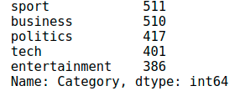
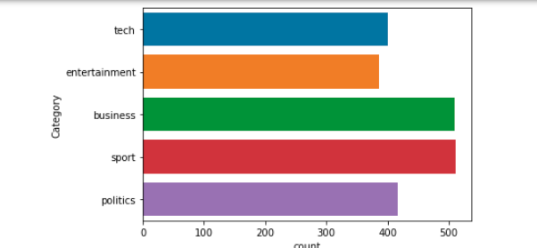
Data Preprocessing
Combining text files into one while preserving observation labels
Under sampling to prevent bias from data imbalance
Need to Convert all characteristic values to numerical Values , Because most ML models not process raw texts

Slide 5
Data Structure
Business
001.txt
002.txt
003.txt
n.txt
Entertainment
Politics
Tech
Sports

Slide 6
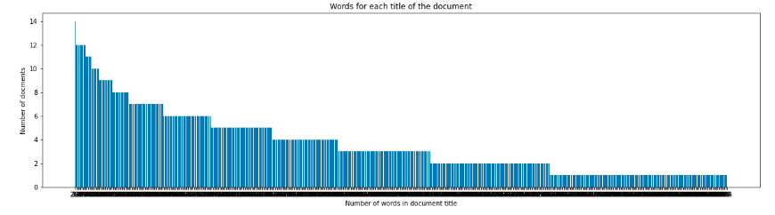
Number of words in dataframe

Slide 7
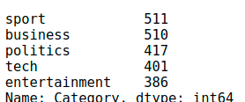
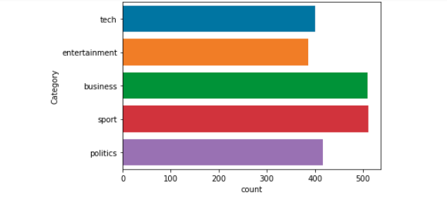
Data Distribution

Slide 8
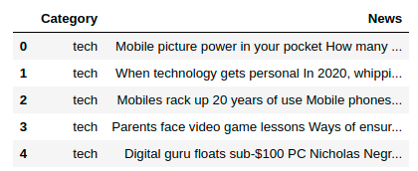

Slide 9
Text Processing
Remove non-alpha convert characters to Lowercase
Removing all stop words
Expanding english language Contraction(ref : stackoverflow)
https://stackoverflow.com/questions/19790188/expanding-english-language-contractions-in-python

Slide 10
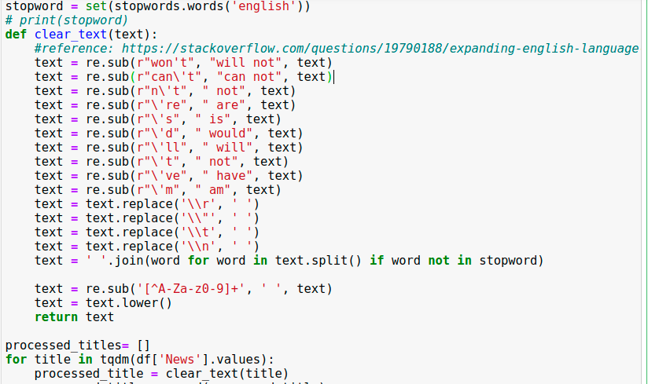

Slide 11
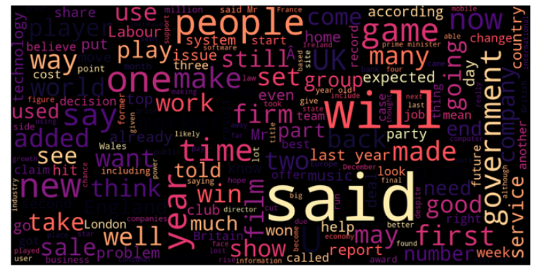
Word cloud after preprocessing

Slide 12
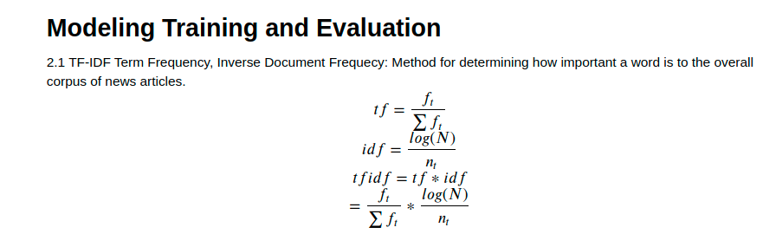
Modeling Training and Evaluation

Slide 13
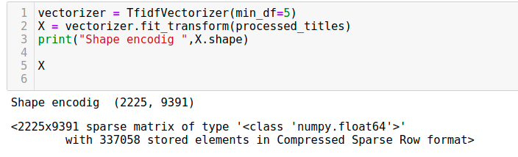

Slide 14
Machine Learning
Advance Model:
OneVSrestclassifier
Random Forest Classifier
Support Vector Classifier
Neural Networks(using Bert, Transformer) in progress..
Base Model:
Logistic Regression

Slide 15
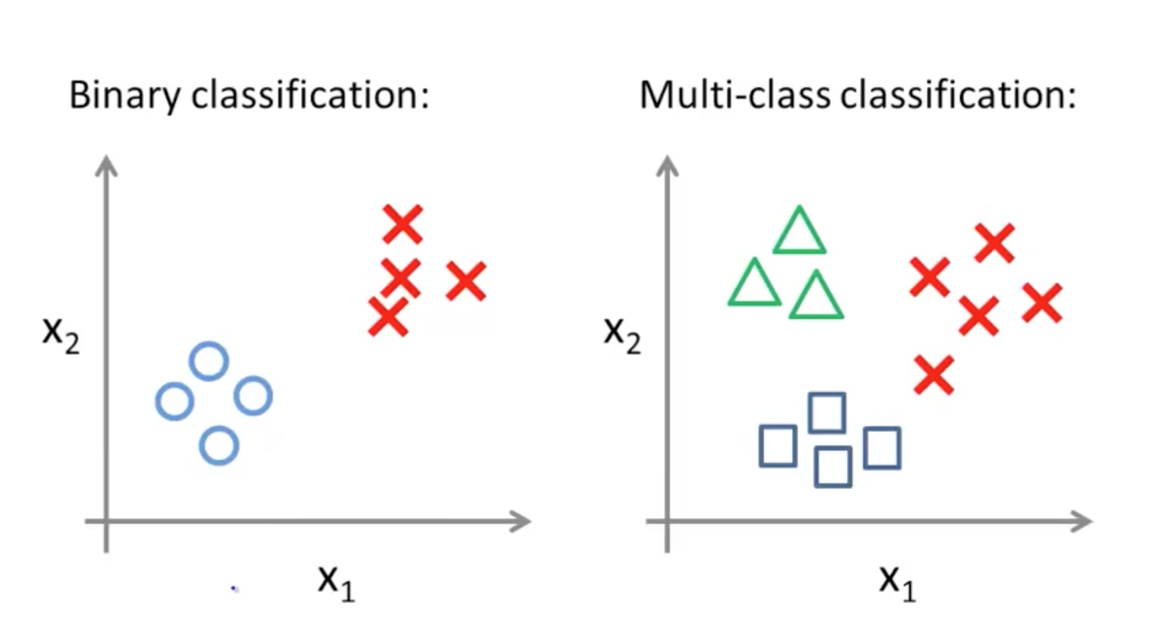
Logistic Regression

Slide 16
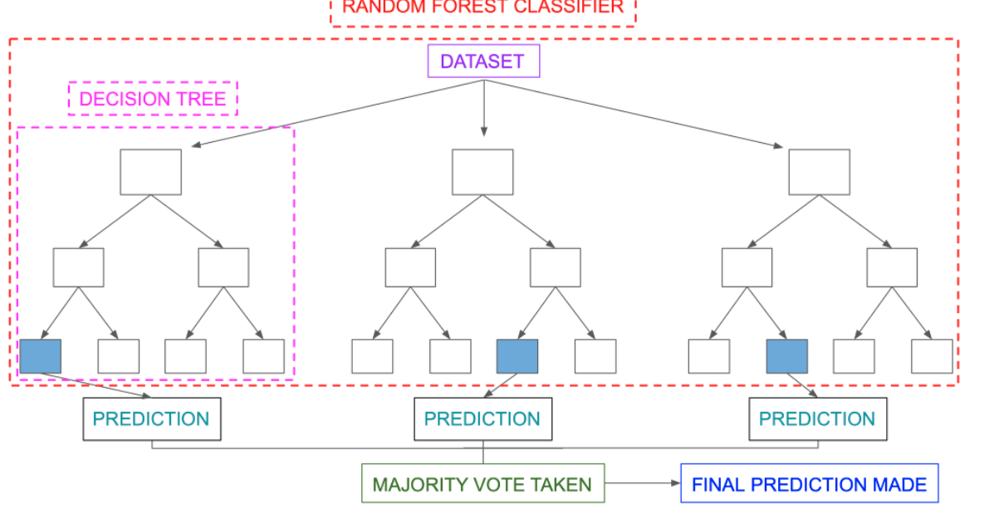
RANDOM FOREST

Slide 17
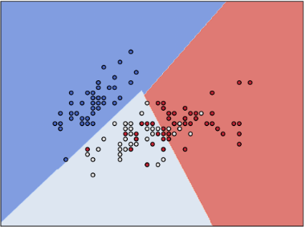
SVC

Slide 18
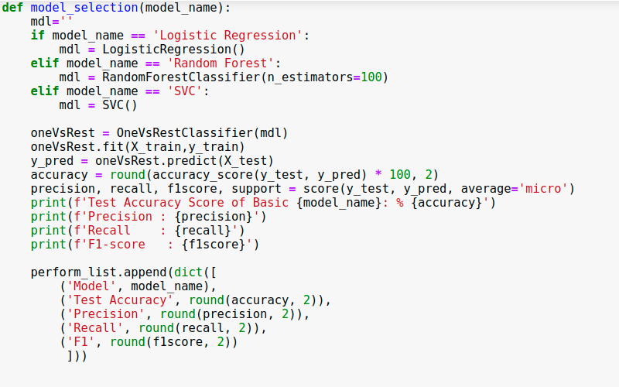
Model Creation

Slide 19
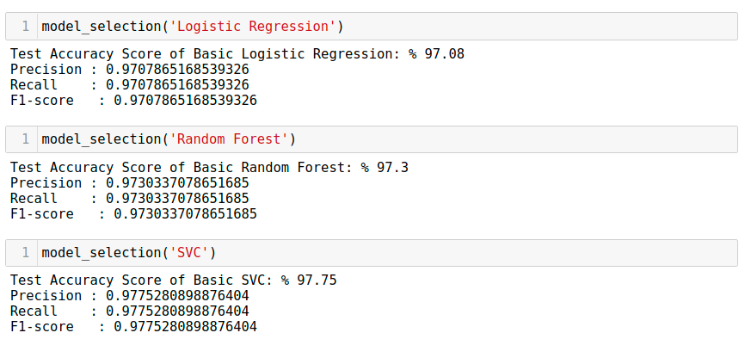
Model Accuracy

Slide 20
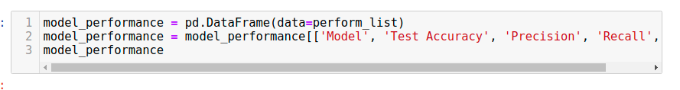
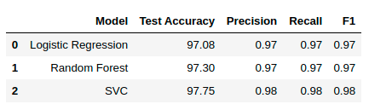
Comparison Performance Metrics

Slide 21
Future Works
Classification Using BERT , Transformer
Model Tuning: K-fold Cross Validation
Multiclass ROC curves
PCA

